Slide 1

Classification and Detection of Fetal Brain Abnormalities using Deep Learning Techniques
Supervised By :
Dr. Zeinab Abd el Haliem
Dr. Sabah Sayed
TA. Nora Abd el Hameed
Presented By :
Aya Khaled
Nourhan Fahmy
Rahma Rashedy
Eslam Hosny

Slide 2
Agenda:
1- Introduction
2- Motivation
3- Problem Statement
4- Project Aim
5- Previous Work
6- Proposed Solutions
7- Project Specifications
8- Conclusion
9-Time Plan
10- References

Slide 3

Introduction
- In today's world, we see that many cases born with disabilities, one of these are brain disabilities.
- Due to delay of discovery of that Appropriate actions are not being taken in the right time so it might lead to permanent disability or even worse consequences like losing the baby.
- the Domain of the idea is medical field, ML, DL, Image processing.

Slide 4

Motivation
- To help doctors to try to detect brain abnormalities during pregnancy and even try to classify it before the babies' born.
- This is In a try of curing the disability and avoid delay which may case risk of losing the fetus or permanent disability.
- Usually in some dangerous cases of abnormalities the fetus dies in the mother womb, hours after birth or even days.

Slide 5
- In other less dangerous cases the fetus could develop to a baby and grow up as a brain disabled person. - Detection and classification are needed to know all that mentioned previous and more importantly it led to the ability of knowing if the case is treatable.
Motivation (cont.)

Slide 6
Problem Statement
Radiologists are not required to diagnose diseases or have in-depth knowledge of radiology-related conditions. Their role is limited to conducting radiology tests and writing reports, and their diagnoses cannot be relied upon.
On the other hand, gynecologists/obstetricians are responsible for diagnosing diseases based on the radiology images they observe.
However, studying radiology, particularly MRI, is a challenge for them as it is outside their specialization.
This is where Deep Learning Techniques roles show its benefit.

Slide 7

• Project Aim
Our Website aims to assist gynecologists/obstetricians by providing easier access to information and helping them classify fetal brain scans as normal or abnormal.
Determine If there is a fetal deformity and its type before the babies' born in a try of curing the disability and avoid delay which may cause a lot risks and circumstances.
This will happen by processing the MRI images and applying deep learning techniques to classify the images.
The application does not replace the doctor but reduces the burden of memorizing theoretical information, allowing them to focus on their field of expertise.

Slide 8
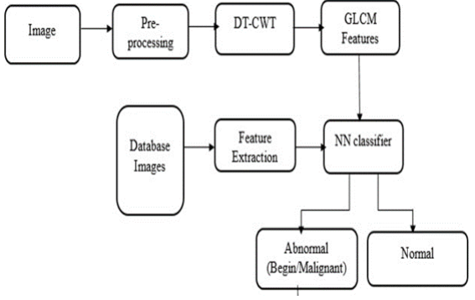
Related Work
Recognition and Classification of Fetal Brain Abnormalities (Published year 2021)
Methodology: 1- preprocessing: resize raw images, turn it to grayscale and remove any noisy data 2- segmentation 3- feature extraction: image go into DT-CWT to extract features then go to GLCM phase to extract texture like Energy, Contrast, Entropy etc. 4- CNN classifier 5- (Graphical User Interface) Dataset: fetal brain atlas, it includes 300 images, (120 normal and 180 abnormal) with GA. Result: CNN to classify between normal and abnormal with accuracy around 92%-93% and it's calculated using accuracy, sensitivity and specificity.
Block diagram of Proposed Algorithm for
(Recognition and Classification of Fetal Brain Abnormalities, April 2021)

Slide 9
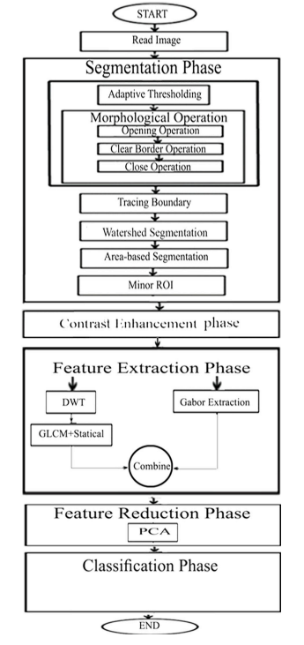
Related Work (cont.)
Methodology: framework in 5 phases: Segmentation enhancement process feature extraction: several methods were used here including DWT, GLCM and Gabor filters. feature reduction using PCA classification: using several methods like KNN, QDA, Random Forest, Naïve Bayes, Radial Basis Function (RBF) Network, Ensemble Classifiers. Dataset: from Atlas of Fetal MRI 227 (113 healthy and 114) unhealthy from week 16 to week 39. Result: calculated using Classification Accuracy, Precision, Sensitivity and Area Under the Receiver Operating Characteristic Curve.
Fetal Brain Abnormality Classiﬁcation from MRI Images of Diﬀerent Gestational Age (Published year 2019)
Diagram describing Proposed Algorithm (Fetal Brain Abnormality Classiﬁcation from MRI Images of Diﬀerent Gestational Age, 2019)

Slide 10
Previous solutions to the problem (cont.)
 | (Recognition and Classification of Fetal Brain Abnormalities, 2021) | Fetal Brain Abnormality Classiﬁcation from MRI Images of Diﬀerent Gestational Age, 2019)
Techniques | CNN (DL) | KNN, QDA, Random Forest, Naïve Bayes, Radial Basis Function (RBF) Network, Ensemble Classifiers. (ML)
Advantages | - Not much preprocessing - Size of Dataset is 300 images - Acceptable Accuracy 92 - 93 % | -High Accuracy -Accuracy 97% achieved by KNN
Disadvantages | -Lower accuracy compared to paper 2 | - A lot of preprocessing - Smaller Dataset 227 image

Slide 11
Proposed solutions
Dataset:
The source of MRI fetal brain images used in this project is from 3 Sources:
1 - Fetal Brain Atlas: It includes 462 images with GA (Gestational Age), around 299 images of healthy brain and around 163 images of abnormal brain) ranging from 16 weeks to 39 weeks.[1]

Slide 12
Proposed solutions (cont.)
2- Fetal Brain MRI from Stanford Lucile Packard Children's Hospital which is only belong to normal class can be found in Stanford Digital Repository website.
3-Radiopaedia which abnormal chases were downloaded from. [3]
Total data set for both classes reached 1105 image, Normal class = 557, Abnormal = 548.
Plus, we later Add Unknown class having around 500 images from different data sets belong to different categories to handle if the user entered random image.

Slide 13
2- Techniques of Preprocessing and Deep Learning - ML and DL are techniques for pattern recognizing and it can be applied on medical images. They are powerful tools that can help to render medical diagnoses. - As they make accurate classification in medical diagnoses and reduce diagnostic errors by clinicians. Why are we Prefer using Deep Learning techniques on ML techniques ?
Proposed solutions (cont.)

Slide 14
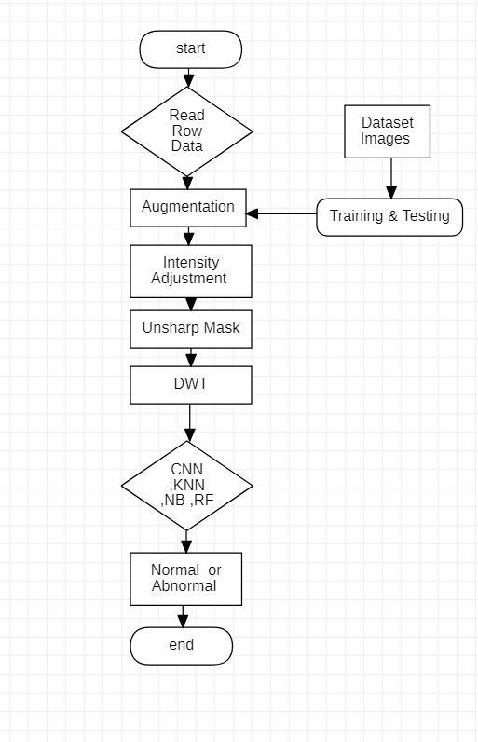
Project specifications
System Architecture Phase 1
-preprocessing: Augmentation on the images, resize the images and gray scale it, intensity adjustment, Unsharp mask to sharpen the edges and DWT to extract the localization.
-classification: enter images to ML and DL to classifiers to obtain the result
Classifiers used here are CNN, KNN, RF, NB.
Flow chart of the Proposed system architecture Phase 1.

Slide 15
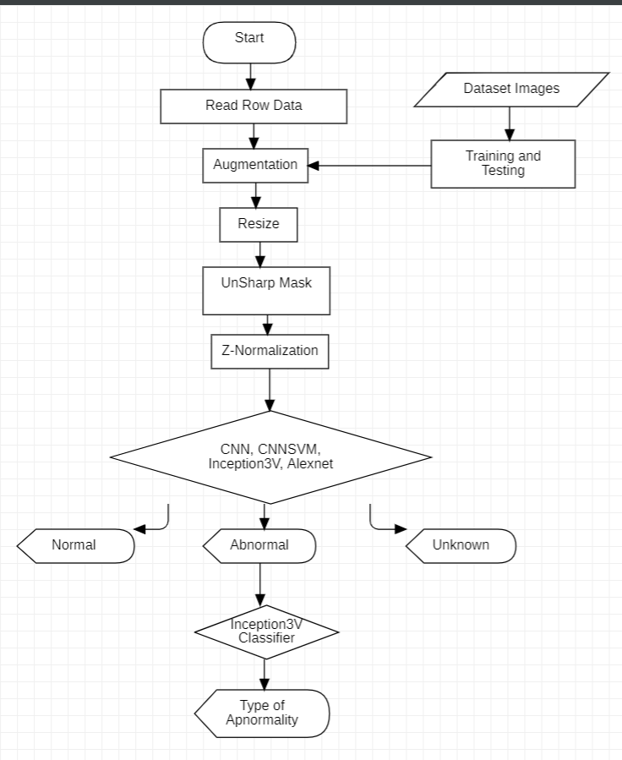
Project specifications
System Architecture Phase 2
Augmentation: 2 Types
Resize: 150 * 150
Enhancing Mask: Unsharp Mask
Normalization: Z-normalization
Flow chart of the Proposed system architecture Phase 2

Slide 16
Project specifications (cont.)
Models: We made 6 models 2 of the are tuned differently (CNN, Inception), with 4 unique model CNN, CNNSVM, Inseption3V, Alexnet.
We Tried different models, including EfficientNetB7, ResNet50 Evaluated results and found CNN, CNN-SVM, Alex Net, and InceptionV3 performed best.
Fine-tuned hyperparameters, starting with batch size and epochs and ending with model architecture.
If the image classification is abnormal it will enter another classifier (Inception3) that will classify its category.

Slide 17
Results
 | Without Augmentation | Augmentation On all data | Augmentation On only Train
CNN Main model (model 2) | Accuracy: 0.92760180995 Precision: 0.928 recall: 0.928 F-Measure: 0.928 | Accuracy: 0.9411764705 Precision: 0.942 recall: 0.941 F-Measure: 0.941 | Accuracy: 0.93636363636 Precision: 0.937 recall: 0.936 F-Measure: 0.936
Inception3V (model 4) | Accuracy: 0.8914027149 Precision: 0.898 recall: 0.891 F-Measure: 0.891 | Accuracy: 0.9788838612368024 Precision: 0.979 recall: 0.979 F-Measure: 0.979 | Accuracy: 0.9 Precision: 0.905 recall: 0.900 F-Measure: 0.900
Alexnet | Accuracy: 0.95776772247 Precision: 0.958 recall: 0.958 F-Measure: 0.958 | Accuracy: 0.9562594268476622 Precision: 0.957 recall: 0.956 F-Measure: 0.956 | Accuracy: 0.93181818 Precision: 0.932 recall: 0.932 F-Measure: 0.932
CNNSVM | Accuracy: 0.90950226244 Precision: 0.910 recall: 0.910 F-Measure: 0.909 | Accuracy: 0.8929110105580694 Precision: 0.893 recall: 0.893 F-Measure: 0.893 | Accuracy: 0.91818181818 Precision: 0.918 recall: 0.918 F-Measure: 0.918

Slide 18
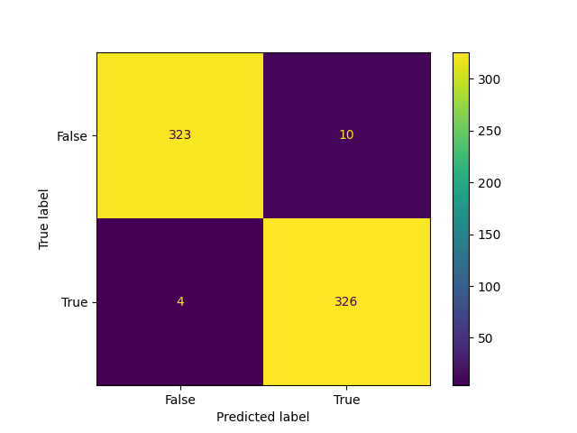
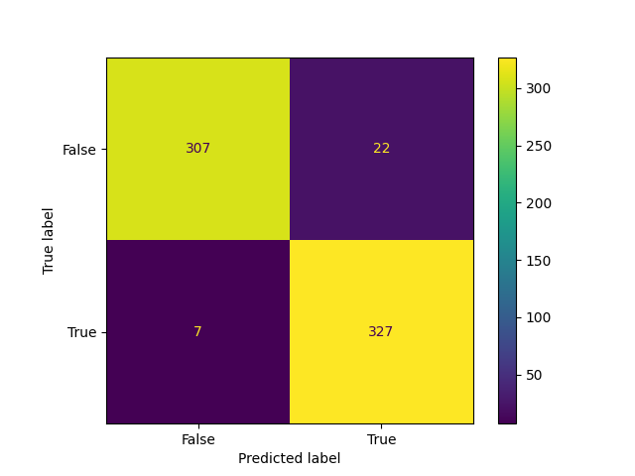
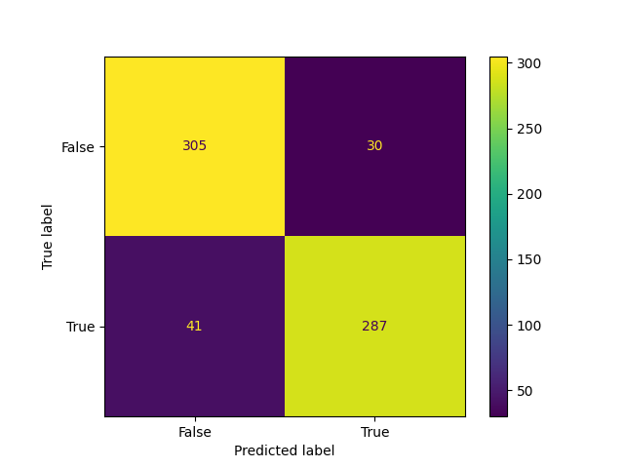
Inception3v
Results (cont.)
Results and Confusion Matrix in Different Classifiers Before Adding Unknown Class:
AlexNet
CNNSVM
Accuracy = 97.9%
Accuracy = 95.7%
Accuracy = 89.3%

Slide 19
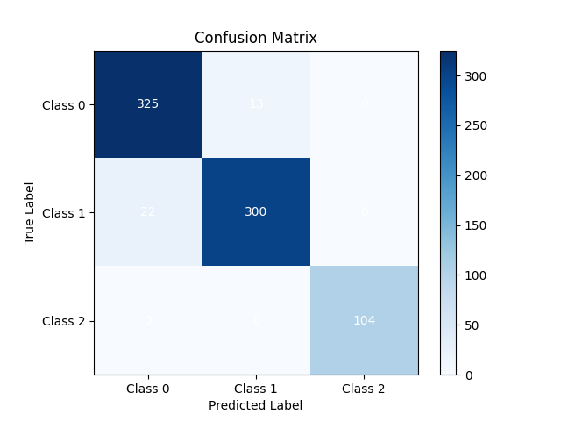
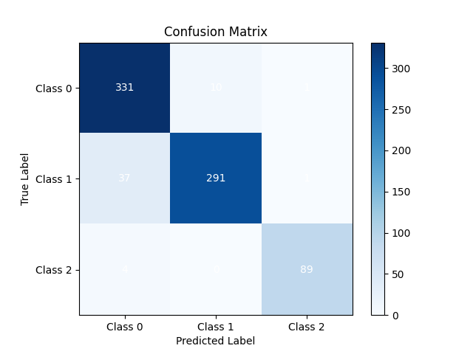
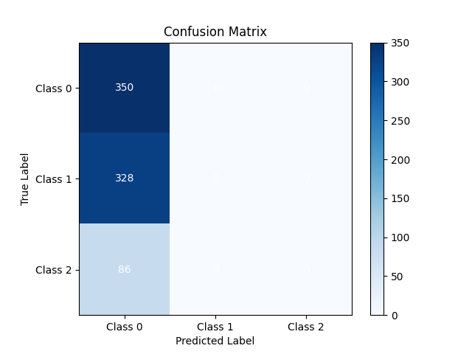
Inception3v
Results (cont.)
Results and Confusion Matrix in Different Classifiers After Adding Unknown Class:
AlexNet
CNNSVM
Accuracy = 95 - 96%
Accuracy = 93%
Accuracy = 20-40%

Slide 20
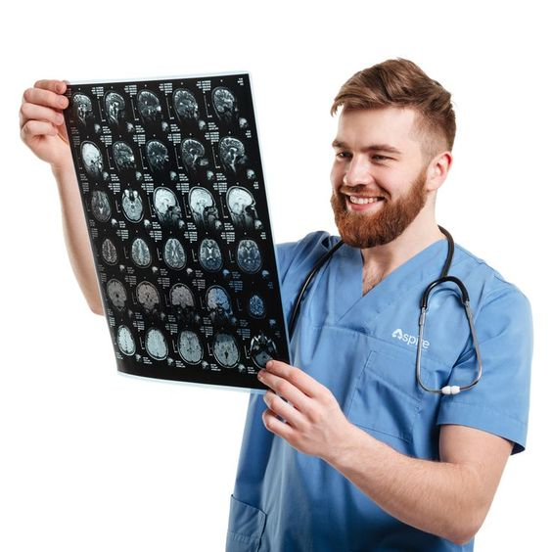
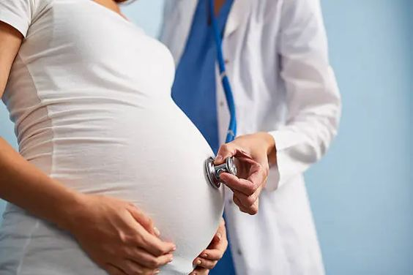
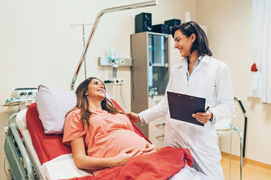
Project specifications (cont.)
- Stakeholders: radiologist, Researchers, gynecologist and obstetrician.

Slide 21
Functional Requirements

Slide 22
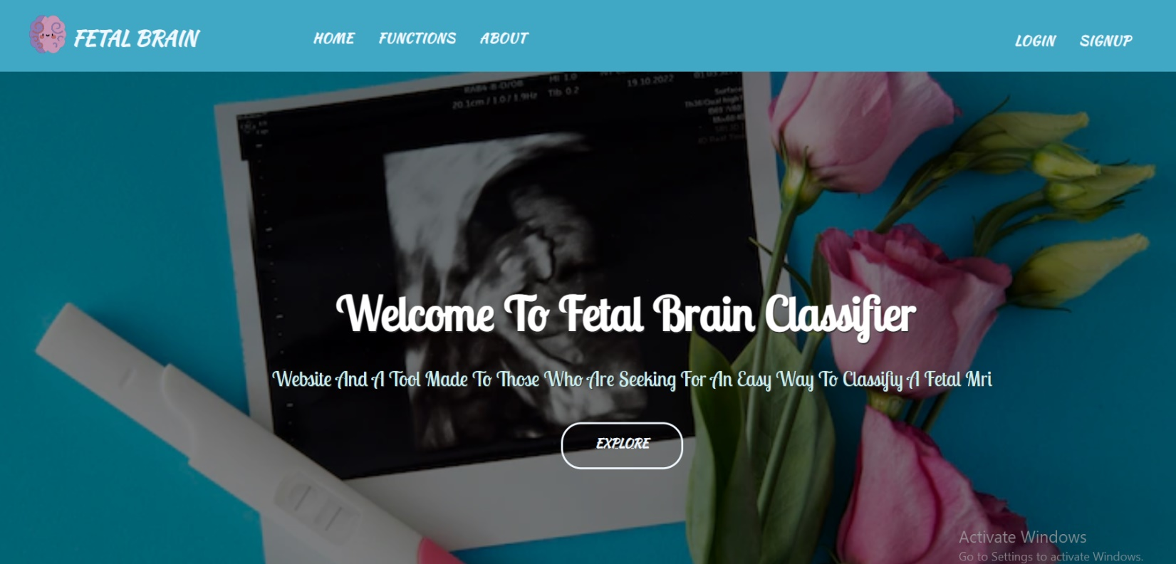
Functional Requirements (cont.)
1- System Requirements
Login / Signup
Classification page
Home
Output

Slide 23
2- User Requirements
Functional Requirements (cont.)
User should be able to sign up if they don't have an account in the website.
Login: user need to be able to login to the system if they already have an email.
User should be able to upload the image they want to classify.
User is able to choose from different models in classification..

Slide 24
Usability
Flexibility
03
01
Reliability
02
Functional Requirements (cont.)
Nonfunctional Requirements
simple and user can interact easily with the application's interface
user won't have to learn complex guide to be able to use it.
Environment
the application should classify the image correctly
04
Our system depends on the number of epochs used to run our model and applies specific filters to images, which could impact its speed or accuracy.

Slide 25
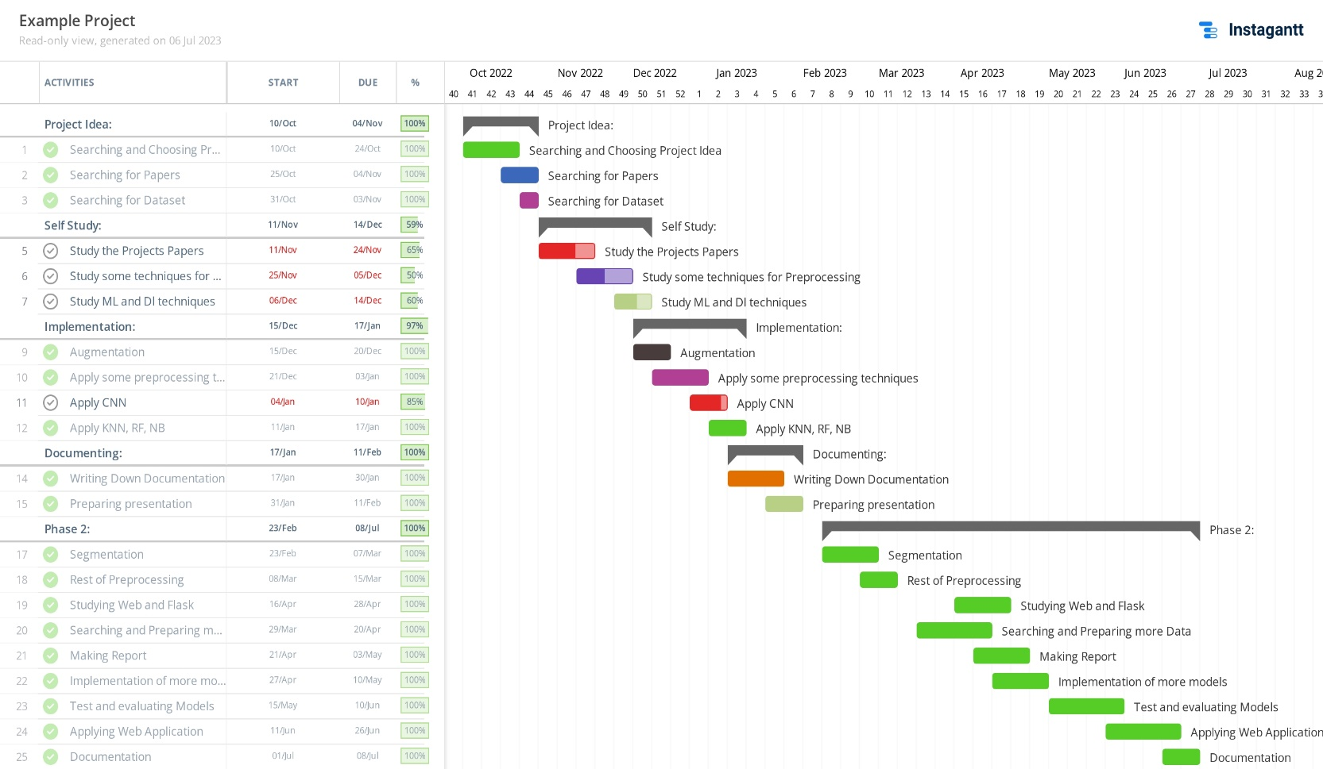
Time Plan
Gantt chart of project time plan

Slide 26
Conclusion
Early detection will indicate many things as possible treatments that can be taken, how the mother will manage the pregnancy.
Treatment of the abnormality doesn’t have to take place while the baby is still in the womb in many cases, That’s why classification of the abnormality should be early not only just for imitate actions, but also for treatment plans right after the birth
Deep Learning Techniques had shown its capability to classify MRI images as long as the data is available and in decent amount. The more the data is large the more accuracy of models is high.
We provided a technique for identifying and categorizing fetal brain abnormalities. For this, we employed deep learning methodologies and algorithms, such as the CNN, Alexnet, CNNSVM, Inception3V algorithm. Our proposed work, in contrast to other studies that achieved the same goals using Deep learning techniques and algorithms, has demonstrated higher accuracy and more effective outcomes. Our accuracy, which is higher than any prior work, was between 97.9%

Slide 27
Future Work
In the future, we aim to add all fetal brain diseases to the classification instead of just six types when we obtain more data diseases like tumors and cerebellar hypoplasia using more techniques we haven't tried yet.
In the upcoming work, we want to increase efficiency, we will expand the data sets.
Finally, We want to work with different types of data sets like 3D datasets as it's the most common type of data in this field on the internet and it defiantly has more features we want to discover.

Slide 28
References
-Fetal MRI: Brain. Available online: https://radnet.bidmc.harvard.edu/fetalatlas/brain/brain.html
-Shen, L., Zheng, J., Shpanskaya, K., McKenna, E.S., Atluri, M., Guimaraes, C.V., Dahmoush, H., Halabi, S.S. & Yeom, K.W. (2021). Fetal Brain MRI from Stanford Lucile Packard Children's Hospital. Stanford Digital Repository. Available at: https://purl.stanford.edu/sf714wg0636
Laura Meeker on 24 Nov 2021, Fetal brain tumors, Radiopaedia.org, Available: https://radiopaedia.org/search?lang=us&modality=MRI&page=1&q=fetal+brain&scope=cases
-Wikimedia Foundation. (2022, September 4). Maternal–fetal medicine. Wikipedia. https://en.wikipedia.org/wiki/Maternal%E2%80%93fetal_medicine
- Vihar Kurama. (2021).ML-based Image Processing. Nononets. https://nanonets.com/blog/machine-learning-image-processing/
- National Institutes of Health. U, S. Department of Health & Human Services Magnetic Resonance Imaging (MRI)
https://www.nibib.nih.gov/science-education/science-topics/magnetic-resonance-imaging-mri
- Saraswathi, E. (2021). Recognition and Classification of Fetal Brain Abnormalities. Turkish Journal of Computer and Mathematics Education (TURCOMAT), 12(9), 2534-2540.‏ https://turcomat.org/index.php/turkbilmat/article/view/3737
- Attallah, O., Sharkas, M. A., & Gadelkarim, H. (2020). Deep Learning Techniques for Automatic Detection of Embryonic Neurodevelopmental Disorders. Diagnostics (Basel, Switzerland), 10(1), 27. https://doi.org/10.3390/diagnostics10010027
- Attallah, O., Sharkas, M. A., & Gadelkarim, H. (2019). Fetal Brain Abnormality Classification from MRI Images of Different Gestational Age. Brain sciences, 9(9), 231. https://doi.org/10.3390/brainsci9090231
- Song, L., Wang, Q., Liu, T., Li, H., Fan, J., Yang, J., & Hu, B. (2022). Deep robust residual network for super-resolution of 2D fetal brain MRI. Scientific Reports, 12(1), 406.‏
https://www.nature.com/articles/s41598-021-03979-1
- Jagadeesh, P., Subashini, S., & Lakshmi, R. V. Detecting and Classifying Fetal Brain Abnormalities Using Deep Learning.‏
https://ijresm.com/Vol.3_2020/Vol3_Iss4_April20/IJRESM_V3_I4_61.pdf

Slide 29

THANKS! Do you have any questions?

